Slide 1


Presented by
Milansinh Parmar ( Zero generation)
Tirthraj Makwana (1st generation)
Umang Vakhariya (2nd generation)
Purushottam Singh (3rd generation)
Ramiz Mansuri (4th generation)
Kuldipsinh Parmar (5th generation)

Slide 2
Introduction
Generation in computer technology is a change in
technology a computer is/was being used.Initially, the
generation term was used to distinguish between hardware
technology.But nowdays, generation includes hardware and
software both, which together make up an entire computer
system.

Slide 3
There are totally five generations of computer
Known till date.
First generation (1945-58) - Vacuum Tubes
Second generation (1958-64) - Transistors
Third generation (1964-74) - Integrated Circuits (IC)
Fourth generation (1974-present) - Microprocessors
Fifth generation (Present-beyond) - Artificial Intelligence

Slide 4
 | First Generation | Second Generation | Third Generation | Fourth Generation
Technology | Vacuum Tubes | Transistors | Integrated Circuits (multiple transistors) | Microchips (millions of transistors)
Size | Filled Whole Buildings | Filled half a room | Smaller | Tiny – Palm Pilot is as powerful as old building sized computer

Slide 5

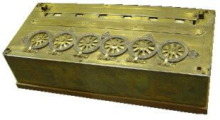
Early age of record keeping
machines are consider as
“0th generation”.
In this age of computers,
machines were used for fast
data calculating as compare to
manual process.
This age is start since 1642 by Blaise Pascal invention
‘Pascaline’. which is mechanical calculating device for
basic addition operations.
Continue….

Slide 6
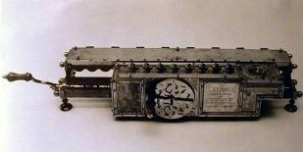
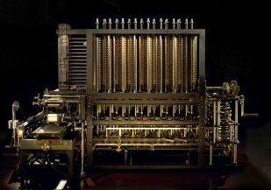
In 1671, Gottfried von Leibniz
Leibniz had invented ‘Leibniz
Wheel’.
This device was used for
additions, subtractions,
multiplications
and divisions operations.
In 1812, Charles Babbage
had developed first
calculator known as
‘Babbage Difference Engine’.

Slide 7

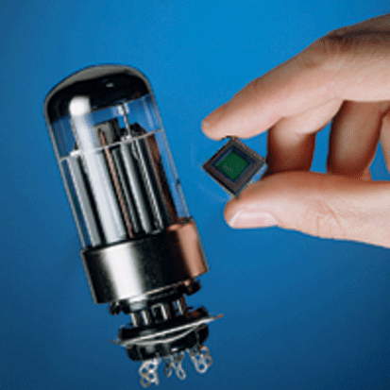
The 1st generation computers
used vacuum tubes for
cicuitry and magnetic drums
for memory.
They were very expensive to
operate and in addition to
using great deal of electricity,
generated a lot of heat, which
was often cause of
malfunctions.
The first generation computers relied on machine language,
the lowest level of programming language understood by
computers to perform operations.
Continue….

Slide 8
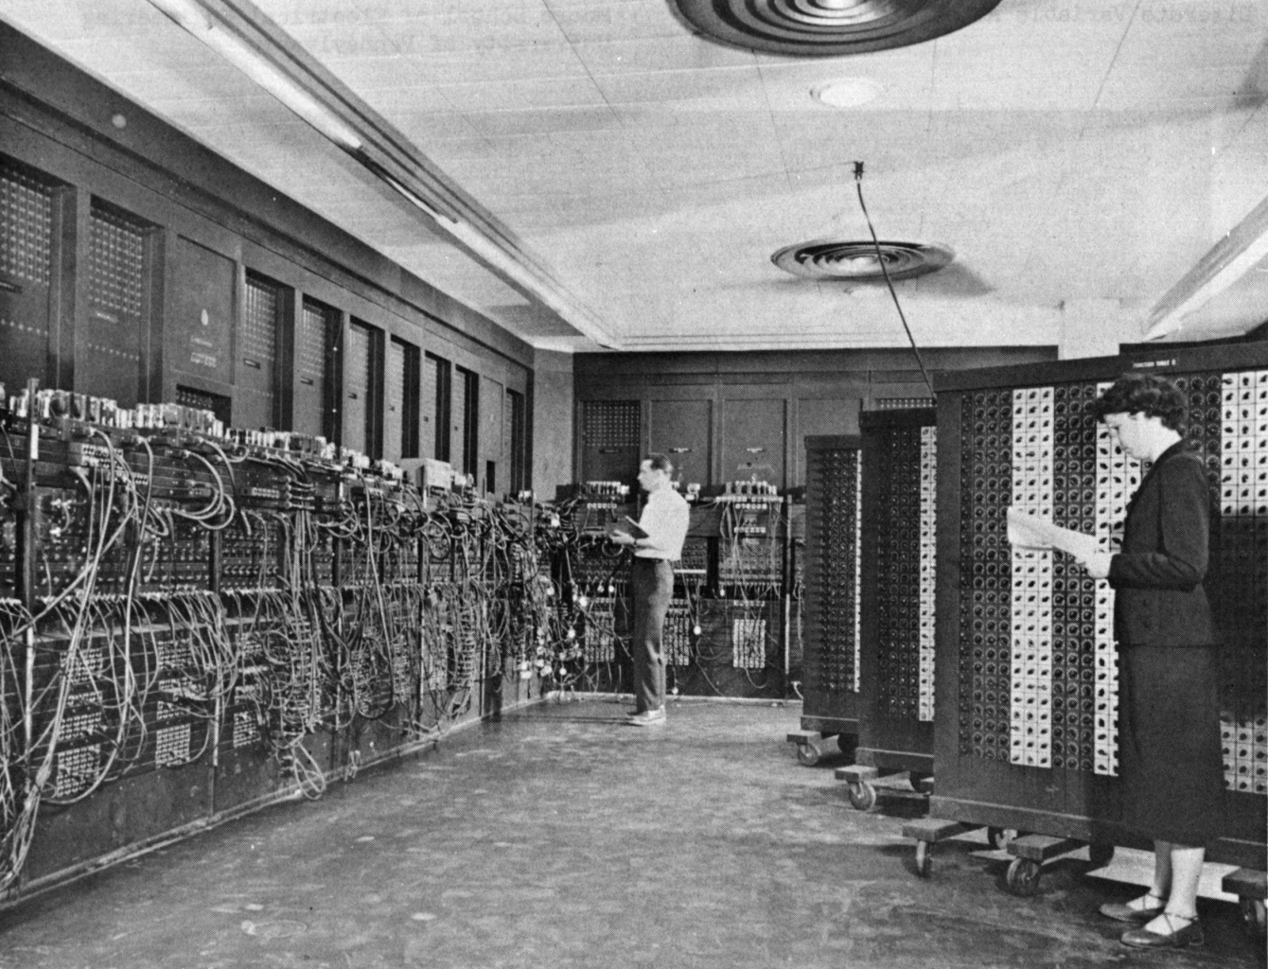
They could only solve one problem at a time.
Input was based on punched cards and papertape and
output was displayed on the screen.
Continue….

Slide 9
Examples:-
Magnetic Drum
4,000 bits
UNIAC - Universal Atomic Computer
ENIAC - Electronic Numeric Integrator and
Computer

Slide 10
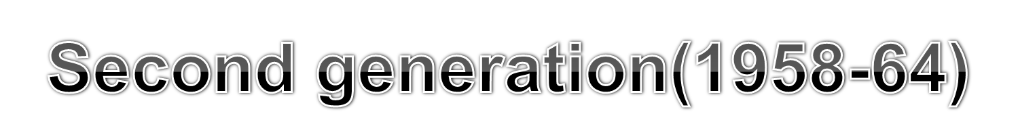
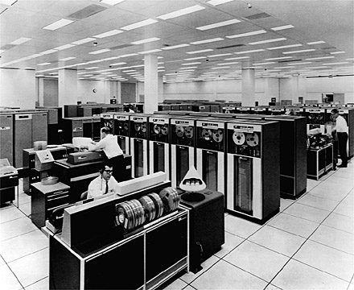
Transistors replaced vacuum
tubes and ushered in the
second generation of
computers.
Second - generation
computers moved from
cryptic binary machine
language to symbolic.
High-Level Programming languages were also being
developed at this time, such as early versions of COBOL and
FORTRAN.
Continue….

Slide 11
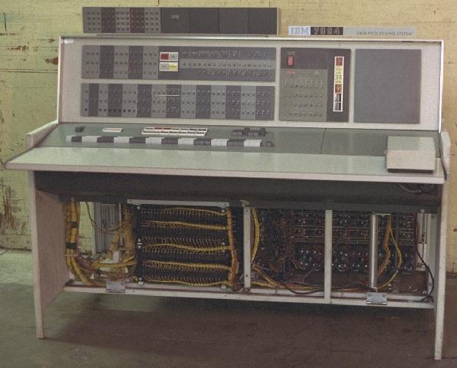
These were also the first computers that stored their
instructions in their memory.
The first computers of this generation were developed for the
atomic energy industry.
Continue….

Slide 12
Examples:-
Magnetic Cores
32,000 bits
Punch Card
CDC - Control Data Corporation

Slide 13

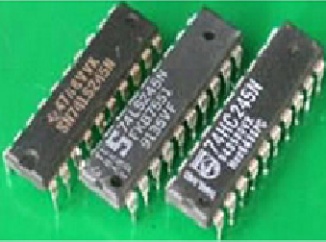
The development of the
Integrated circuits was the
hallmark of the generation of
computers.
Transistors were miniaturized
and placed on silicon, called
semiconductors.
From small scale integrated circuits which had about 10
transistors per chip, medium scale integrated circuits with 100
transistors per chip.
Continue….

Slide 14
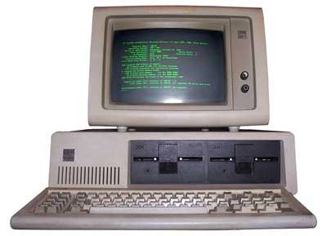
The extremely powerful CPU with the capacity of carrying out
1 million instructions per second.
Allowed the device to run many different applications one
time.
Continue….

Slide 15
Examples:-
Silicon Chips (Integrated circuits)=IC
128,000 bits
Keyboard Entry
IBM - International Business Machines

Slide 16

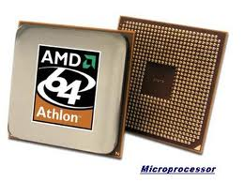
The microprocessor brought
the fourth generation of
computers, as thousands of
integrated circuits were built
onto a single silicon chip.
The Intel 4004 chip,
developed in 1971, located
all the components of the
computer.
From the central processing unit and memory to input/output
controls on a single chip.
Continue….

Slide 17
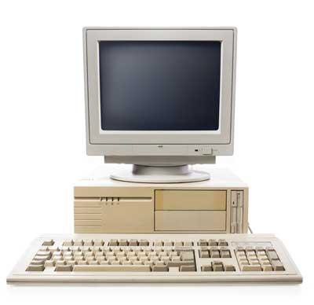
Microprocessors also moved out of the realm of desktop
computers and into many areas of life as more and more
everyday products began to use microprocessors.
Fourth generation computers also saw the development of
GUIs the mouse and handheld devices.
Continue….

Slide 18
Examples:-
Silicon Chips (Large scale integrated circuits)=LSI
100 million bits
Read programs off disks
Xerox

Slide 19

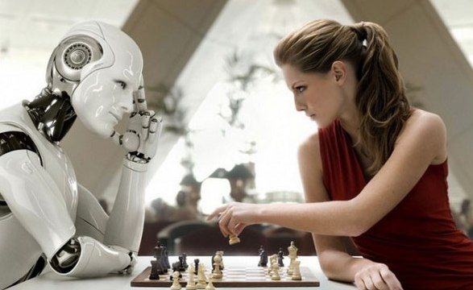
We have seen that in the last
four decades there has been
many inventions and
development in the field of
computer.
So, after 1990 a new
generation of computer
called the fifth generation.
Leading countries for these computer are Japan, U.S.A, they
have been undertaking different projects to design fifth
generation computer.
Continue….

Slide 20
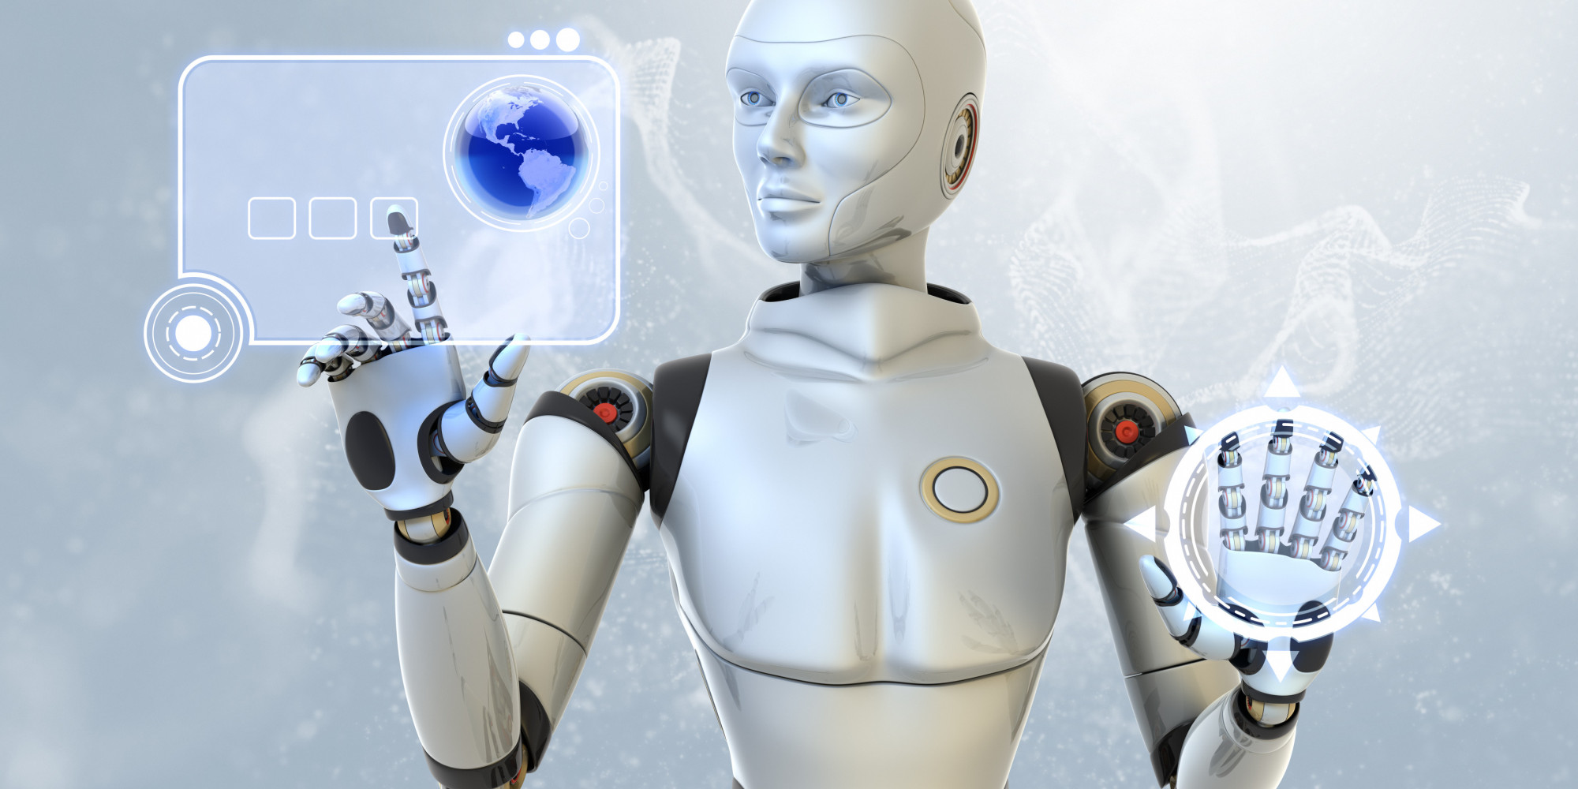
These fifth generation computers will have their own features.
They will be using Silicon Chips (Very large scale integrated
circuits)=VLSI. Such chips will have million of components.
Continue….

Slide 21
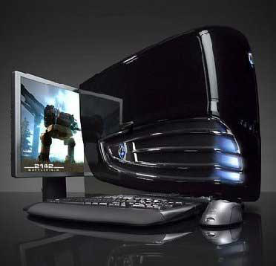
Advantages of fifth generation computers:-
These computer are much faster than first, second, third, and
fourth generation computers.
It’s easier to repair these computer.
These computer are much smallest in size than other
generation computers.
Continue….

Slide 22
Examples:-
      Silicon Chips (Very large scale integrated
circuits)=VLSI
      Unlimited bits
      Cd Rom
      Optical Disk

Slide 23


Information is Power
Thank You

